Slide 1
Android App Development
PART 4
Birzeit University, Samer Zein (PhD)

Slide 2
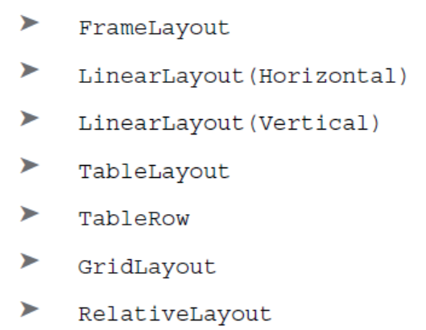
Views and view groups
An activity contains views and ViewGroups.
A view is a widget that has an appearance on screen.
Examples of views are buttons, labels, and text boxes.
One or more views can be grouped into a ViewGroup.
A ViewGroup provides the layout in which you can order the appearance and sequence of views. Such as ScrollView.
Another type of ViewGroup is a Layout.
Examples of Layouts are:

Slide 3
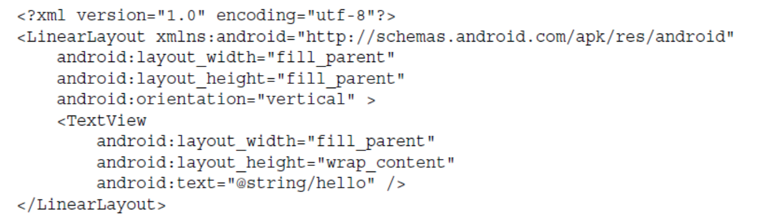
LinearLayout
Vertical or Horizontal, you can also Mix between the two in the same Activity.
Very Simple and basic.

Slide 4
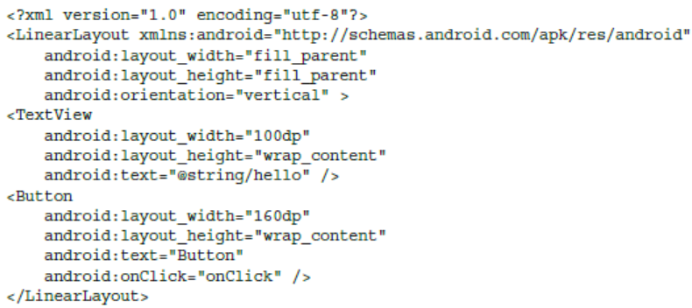
LinearLayout: Density Independent Pixel
1 dp is equivalent to one pixel on a 160 dpi screen.
This is the recommended unit of measurement when you’re specifying the dimension of views in your layout. The 160 dpi screen is the baseline density assumed by Android.

Slide 5
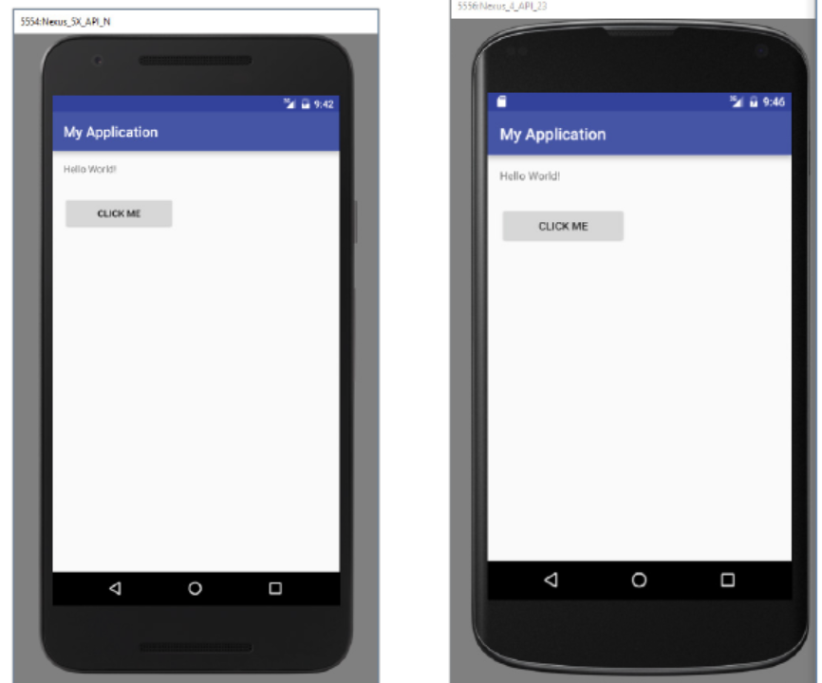
Example Using Density Independent Measurement

Slide 6
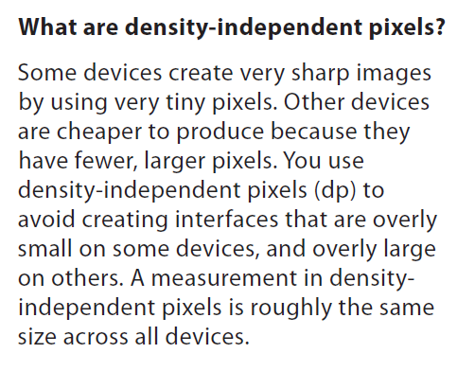
More about Linear Layout
The views’ width and height are mandatory.
You can set android:layout_width and android:layout_height to "wrap_content", "match_parent" or a specific size such as 8dp—that’s 8 density-independent pixels.

Slide 7
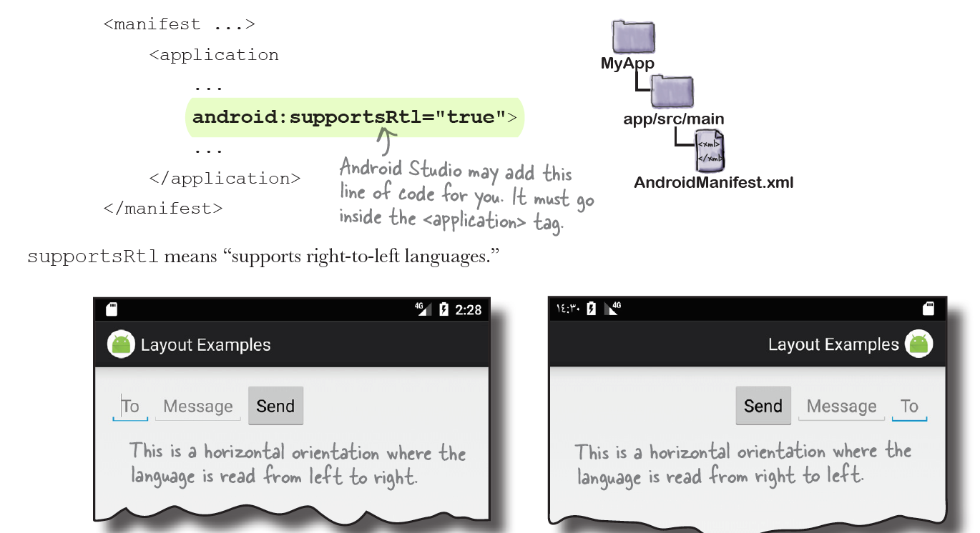
Change Orientation

Slide 8
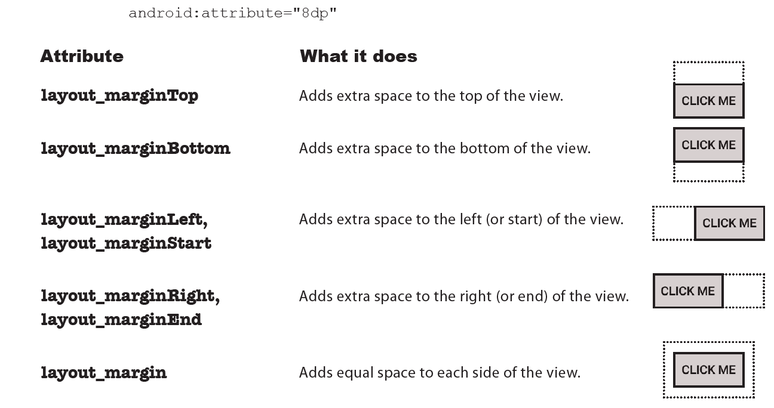
Setting Margins

Slide 9
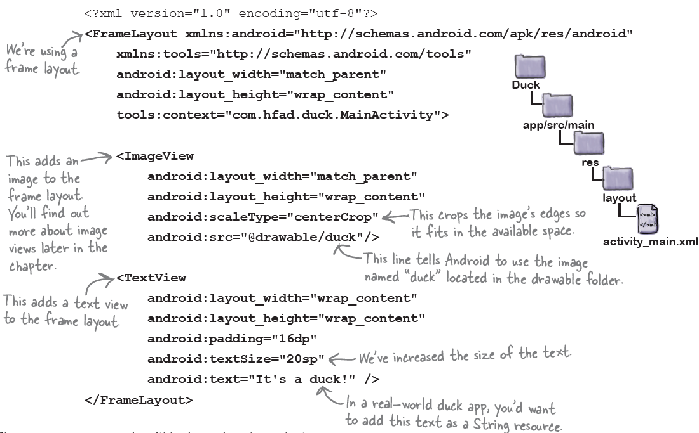
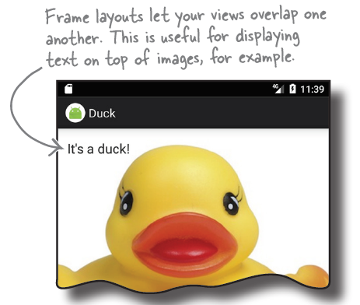
Frame Layout: stacks the views

Slide 10
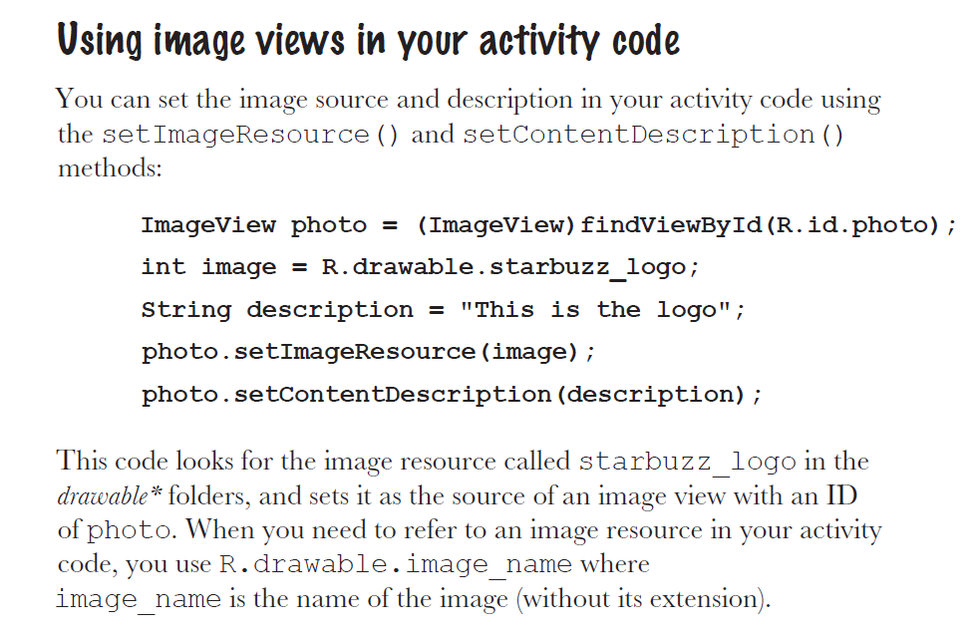

Slide 11
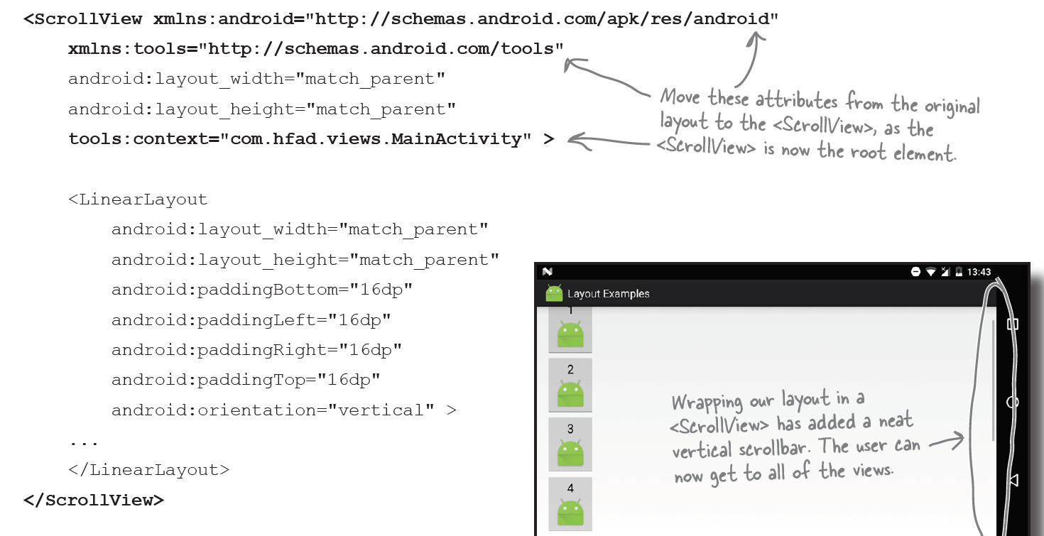
Scroll View

Slide 12
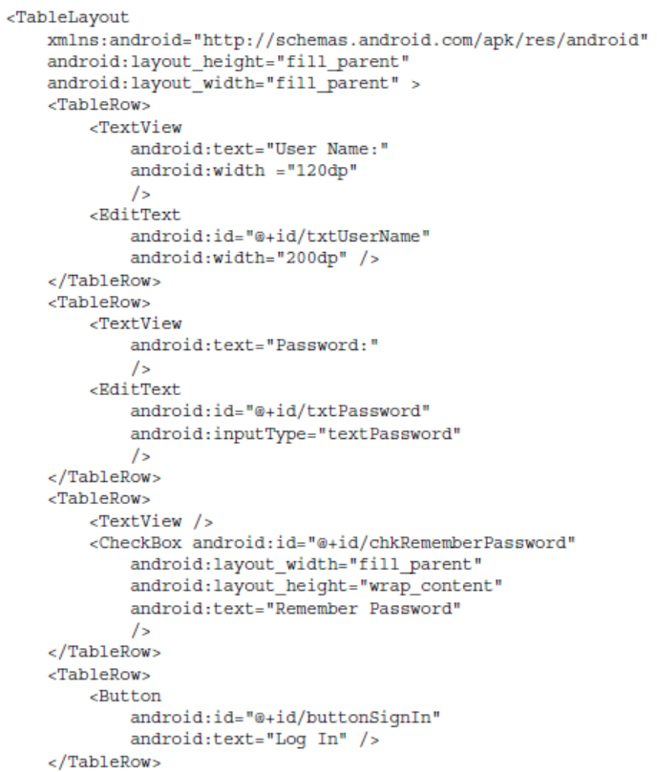
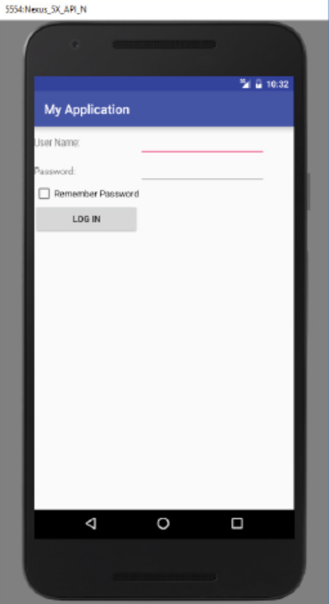
Table Layout
The TableLayout Layout groups views into rows and columns.
You use the <TableRow> element to designate a row in the table.
Each row can contain one or more views

Slide 13
Relative Layout
The RelativeLayout layout enables you to specify how child views are positioned relative to each other.
A RelativeLayout is a very powerful utility for designing a user interface because it can eliminate nested view groups and keep your layout hierarchy flat, which improves performance.

Slide 14
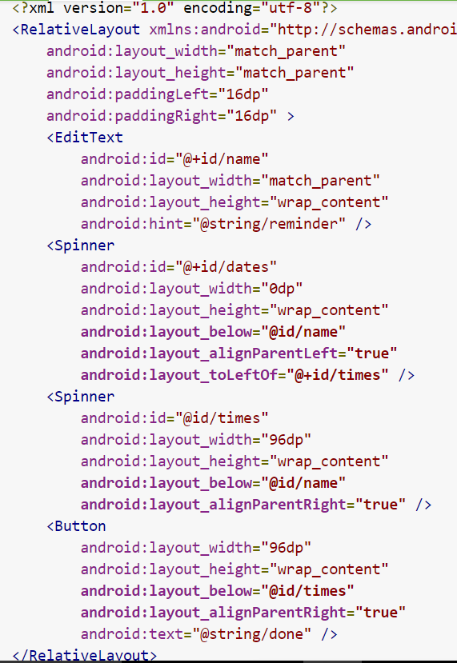
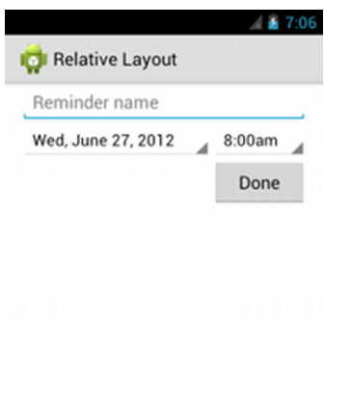

Slide 15
Adapting to Display Orientation
One of the key features of modern smartphones is their ability to switch screen orientation.
Android supports two screen orientations: portrait and landscape.
When you change the orientation of your Android device, your current activity is actually destroyed and then re-created.

Slide 16
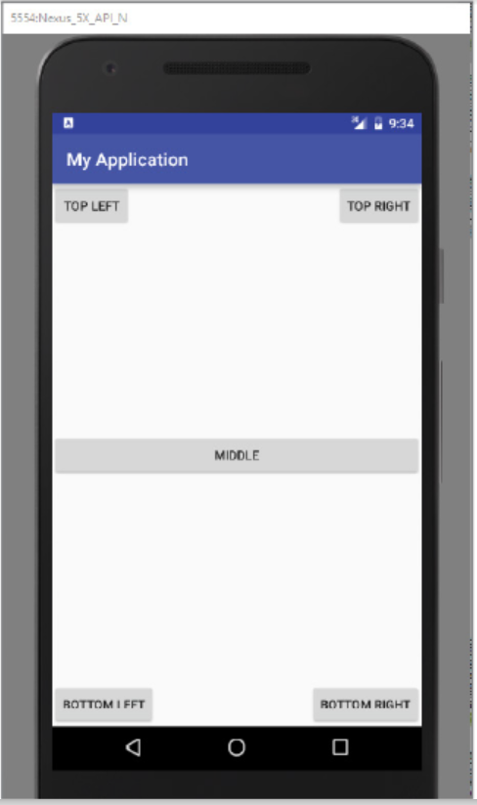
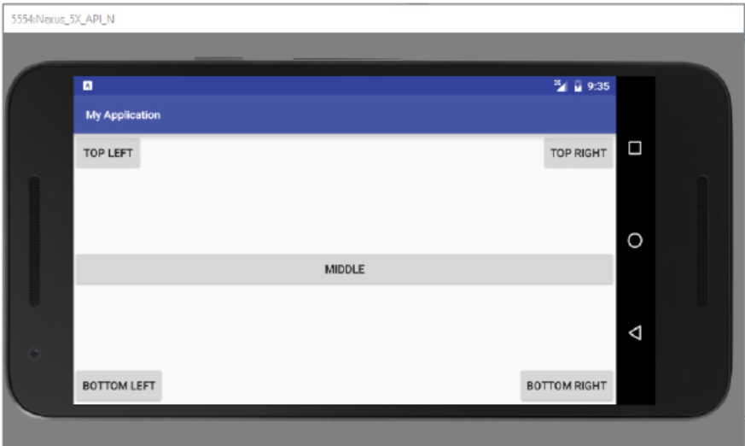
Adapting to Display Orientation: Anchoring Using Relative Layout

Slide 17
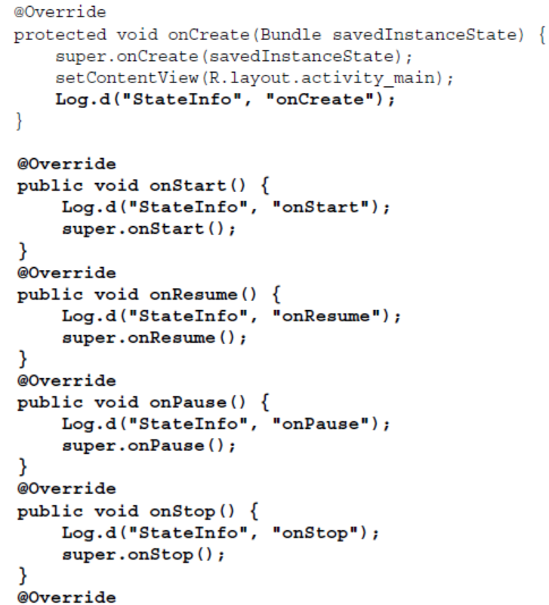
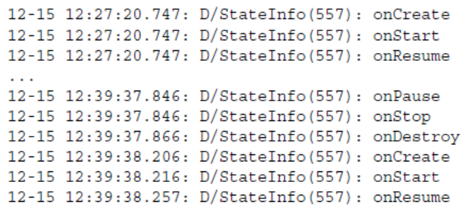
Managing Changes to Screen Orientation

Slide 18
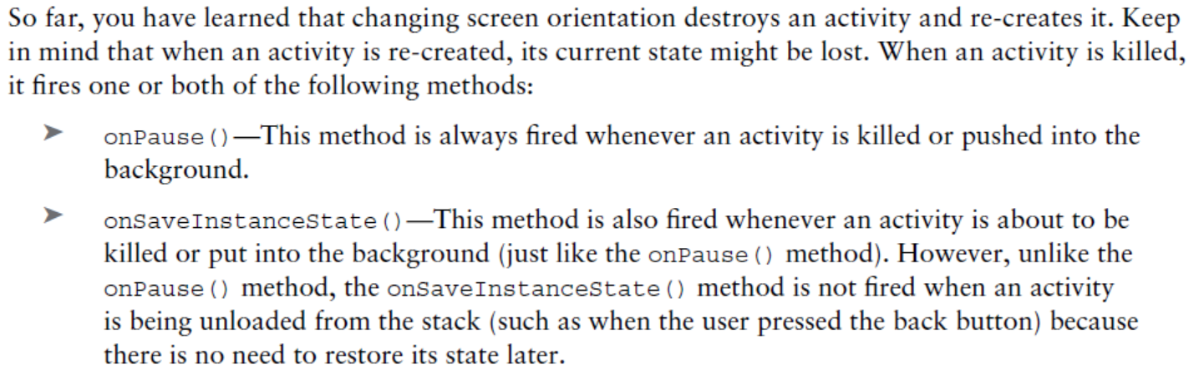
Persisting State Information During Changes in Configuration

Slide 19
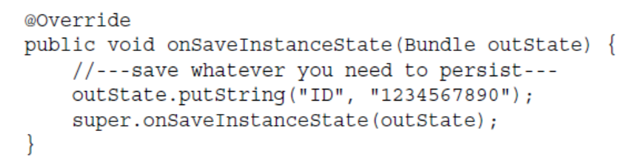
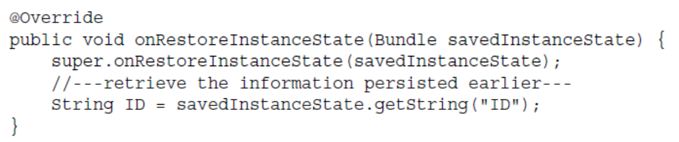
Persisting State Information During Changes in Configuration..2

Slide 20
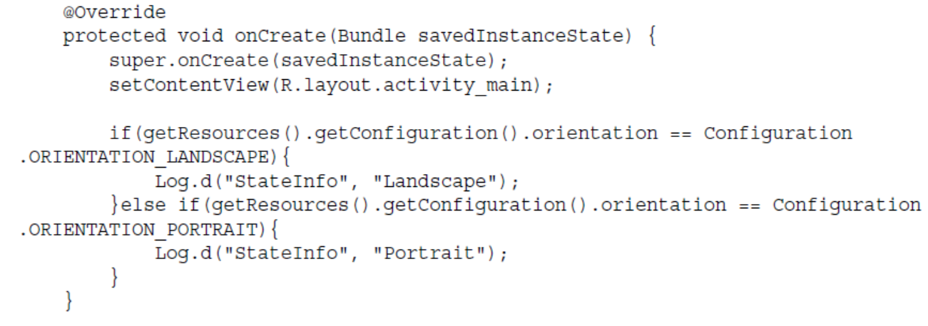
Detecting Orientation Changes

Slide 21
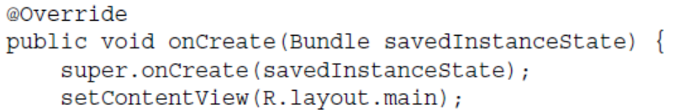
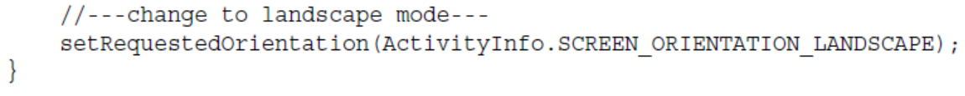
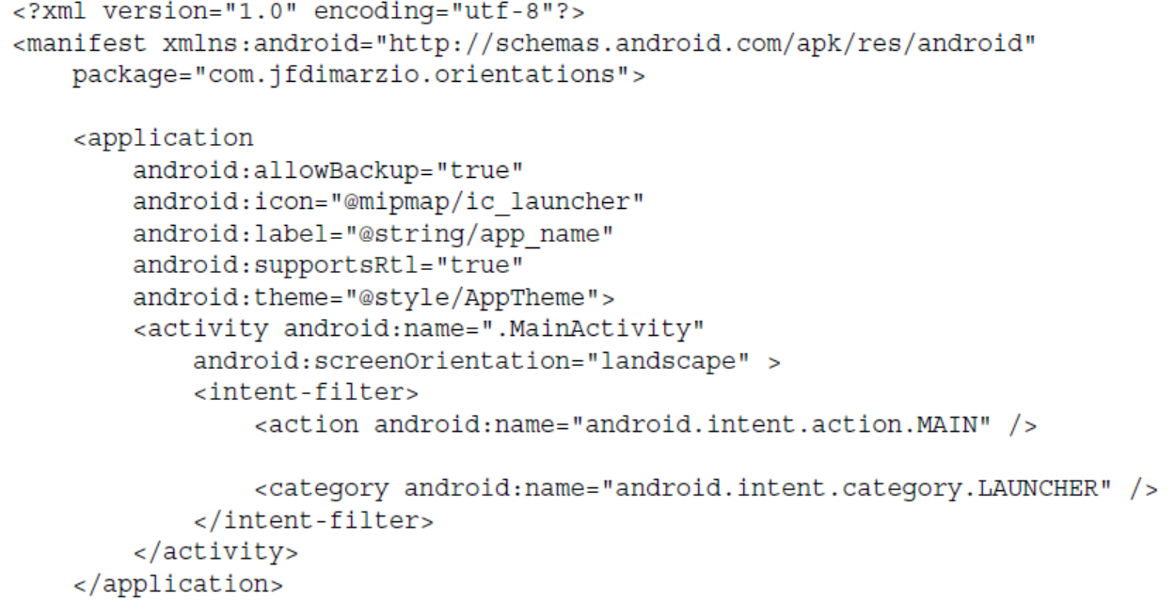
Controlling the Orientation of the Activity

Slide 22
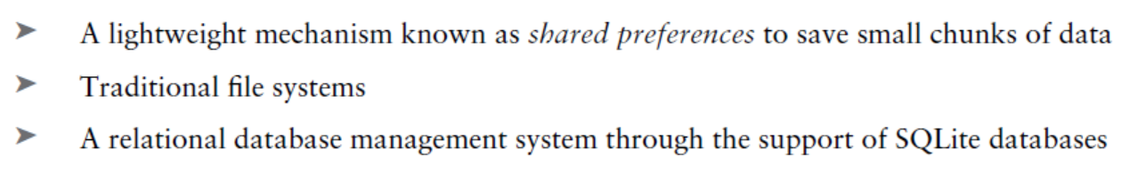
Data persistence
Persisting data is an important topic in application development because users typically expect to reuse data in the future.
For Android, there are primarily three basic ways of persisting data:

Slide 23
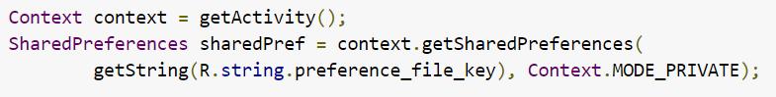
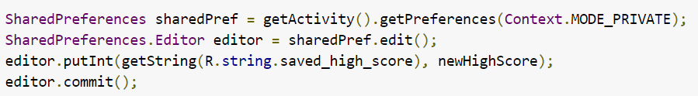
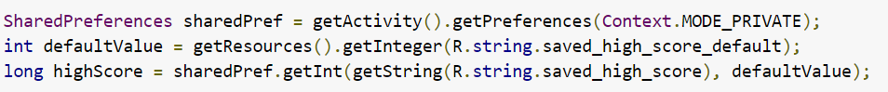
Persistence using shared preferences:
It is basically a light-weight and efficient persistence technique.
Using name-value mechanism.
Initializing
Writing
Reading/loading

Slide 24
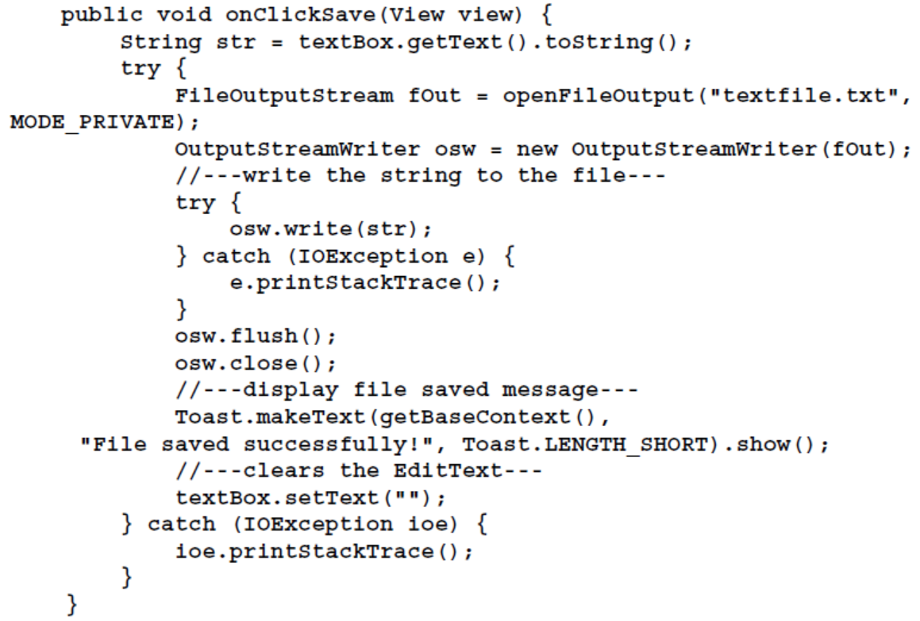
Persistence to internal files

Slide 25
Content providers
Content providers can help an application manage access to data stored by itself, stored by other apps, and provide a way to share data with other apps.
They encapsulate the data, and provide mechanisms for defining data security.
Content providers are the standard interface that connects data in one process with code running in another process.
Implementing a content provider has many advantages.
Most importantly you can configure a content provider to allow other applications to securely access and modify your app data as illustrated in next slide

Slide 26
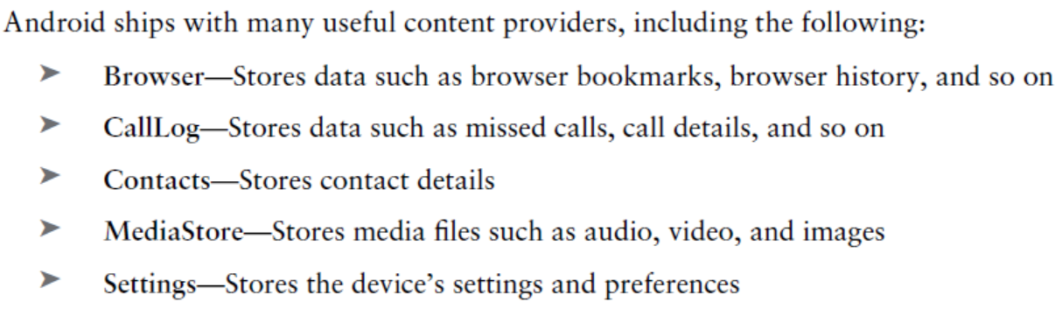
Already installed content providers
The Android framework includes content providers that manage data such as audio, video, images, and personal contact information

Slide 27
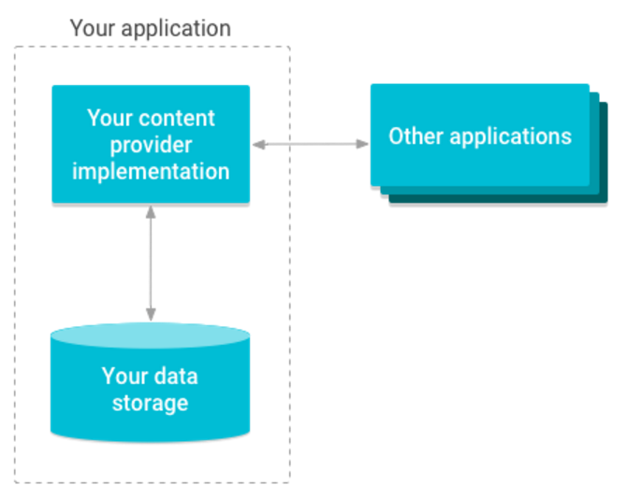
Content Provider Architecture

Slide 28
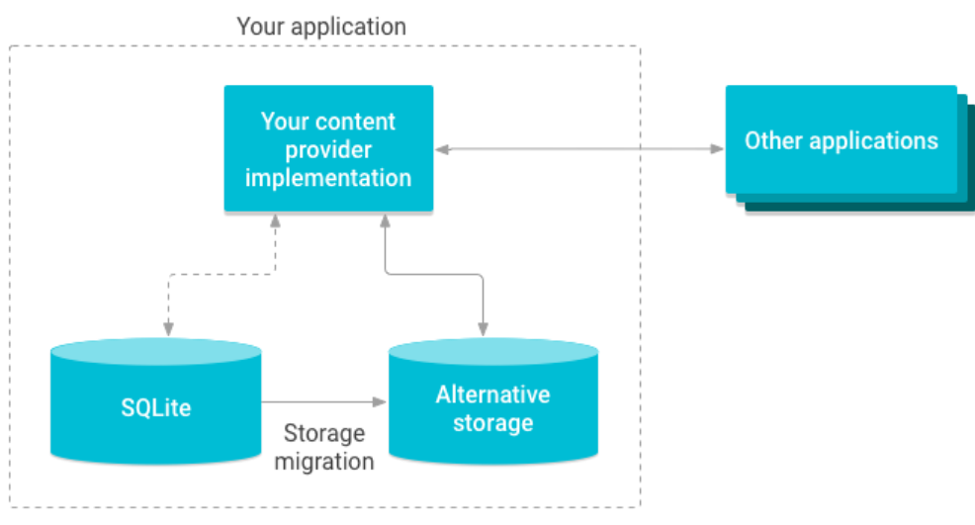
Content provider is a way of abstraction
Use content providers if you plan to share data.
If you don’t plan to share data, you may still use them because they provide a nice abstraction, but you don’t have to.
This abstraction allows you to make modifications to your application data storage implementation without affecting other existing applications that rely on access to your data

Slide 29
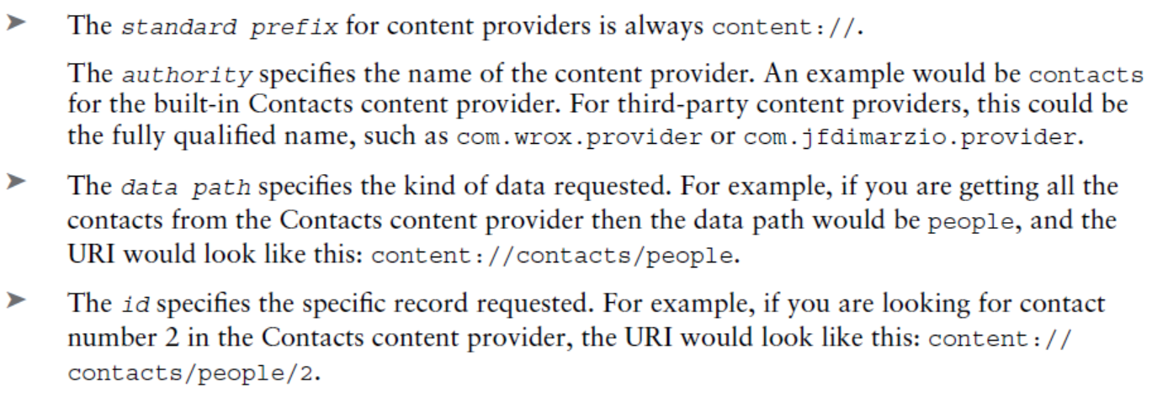
Querying Content Provider
To query a content provider, you specify the query string in the form of a Uniform Resource Identifier (URI), with an optional specifier for a particular row.
The format of the query URI is
<standard_prefix>://<authority>/<data_path>/<id>

Slide 30
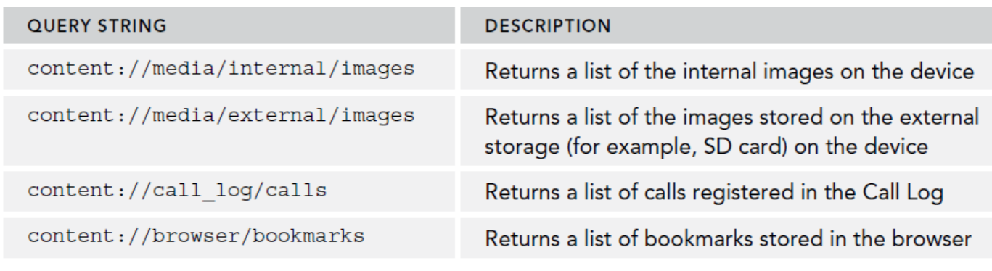
Querying content providers: Examples

